Slide 1

Presented by: Tech Pirates

Slide 2






Team Members –
Mounika
Pallisetti
Anushree
Kulkarni
Ajinkya
Devshette
Priya
Kadam
Arjun
Mani
Meera
Bandle

Slide 3
AGENDA
Product Positioning
Early Adopter Segment
Branding
Channel Strategy
Pricing Strategy
CAC (Customer Acquisition Cost) and LTV (Lifetime Value)

Slide 4
Idea
A one-stop solution to finding flats and people to share flat with! ​
One of the most important action items for anyone who is moving away from home is to find a place to stay that feels like home, while at the sme time, also looking for other people to share the flat with who are compatible with you and can better gel up with you. This is where our idea comes into the picture!

Slide 5

FLAT AND FLAT MATES
Product Positioning

Slide 6
Value Proposition
Creating an easy-to-use experience for new and international students, including but not limited to features such as searching for Roommates and Flat mates, a user rating-base system, furthermore services for new customers, such as lease agreements, rent discounts for premium users, relocation services, and last but not least, earn free travel by accumulating points.

Slide 7
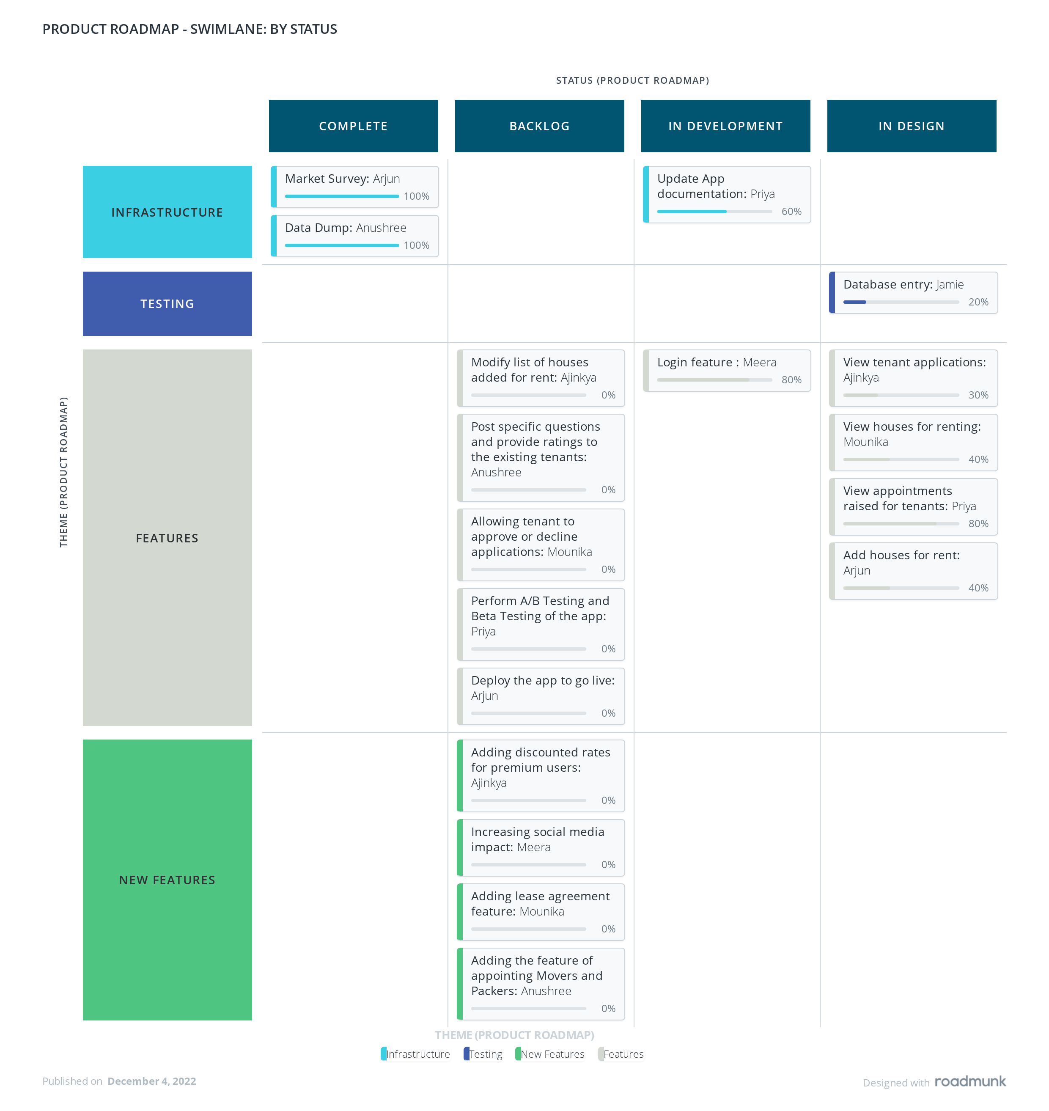
Roadmap
Swimlane View Roadmap: A theme-oriented visualization of roadmap items that works best for "no dates" roadmaps or more agile roadmaps that can be pivoted on themes, sprints, or epics.

Slide 8
FLAT AND FLAT MATES
GO-TO MARKET PLAN

Slide 9





Branding
Flat and Flat-mates
One stop solution to your housing needs as an international student in the US.
Helpful!
Sincere!
Fun!
Trustworthy!
Roomies, Homely, Nest, Home Away, Flat and Flat-mates, Dwelling, Accomme, Homestead​

Slide 10
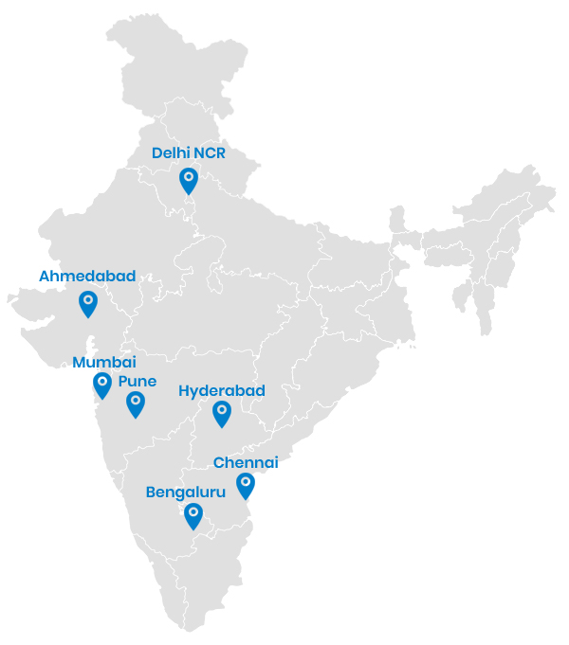
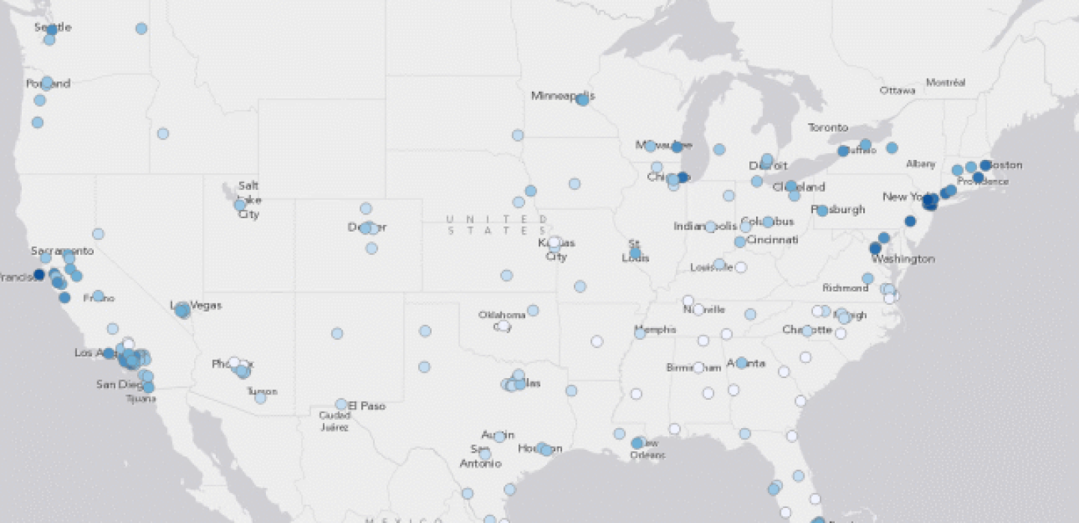










Marketing
Digital Marketing
Education Consultancies/ University Tie ups
Referral Benefits
Alum/Friends/Word of mouth
Official Channels and
Influencers Partnership Program

Slide 11
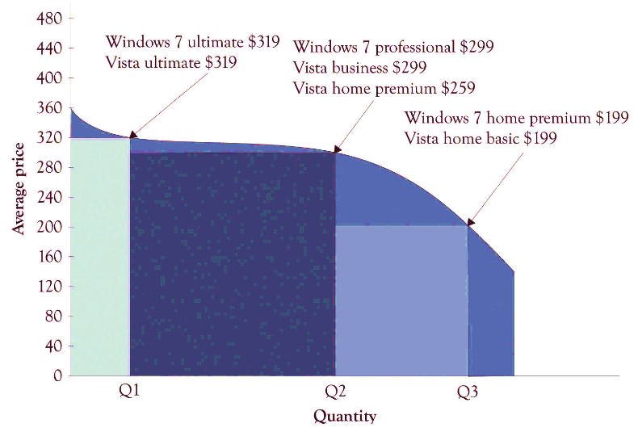
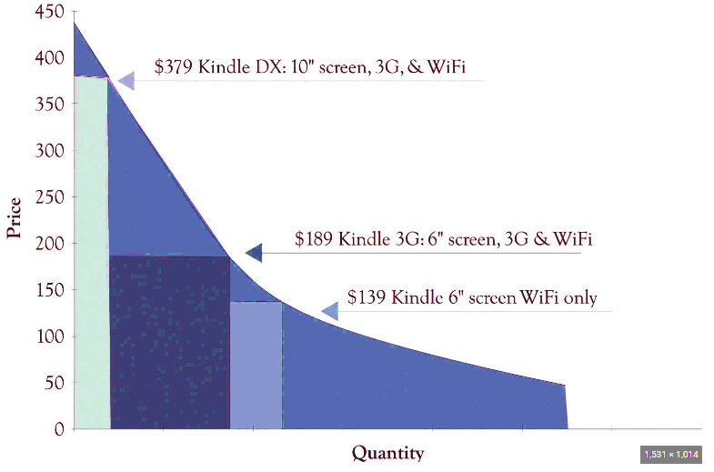
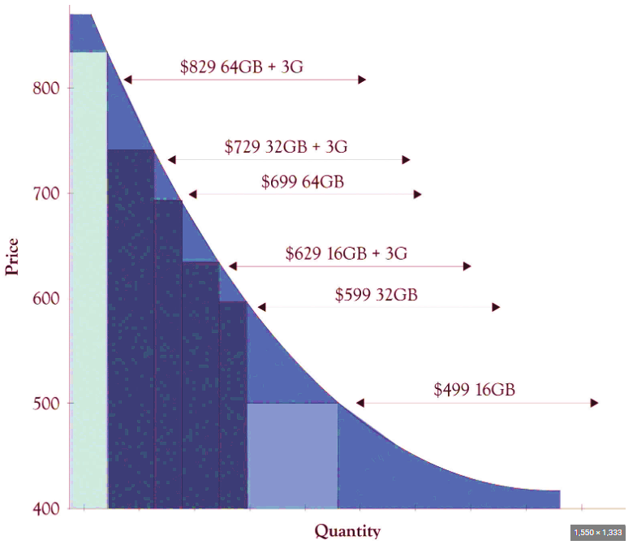
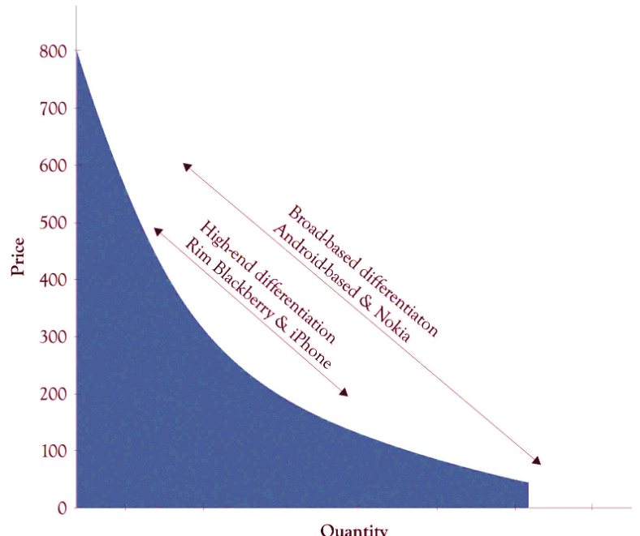
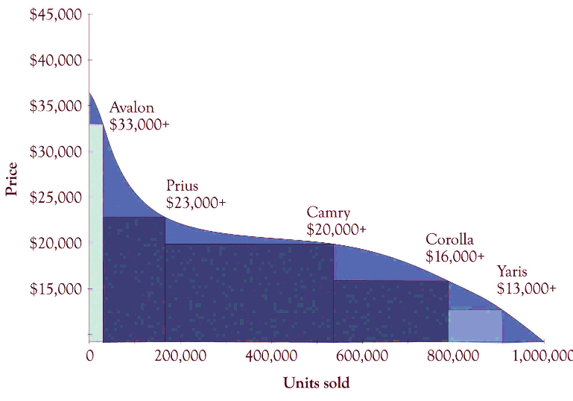
Pricing Strategy
We did some research on existing relationship curves for different product types, on the internet….
BUT found nothing for Housing industry….

Slide 12
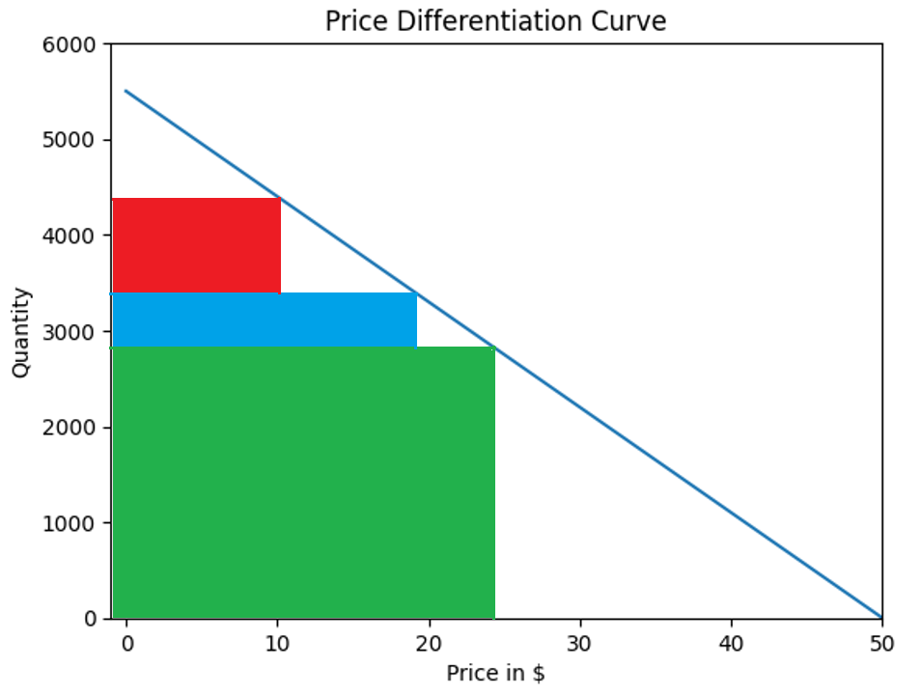
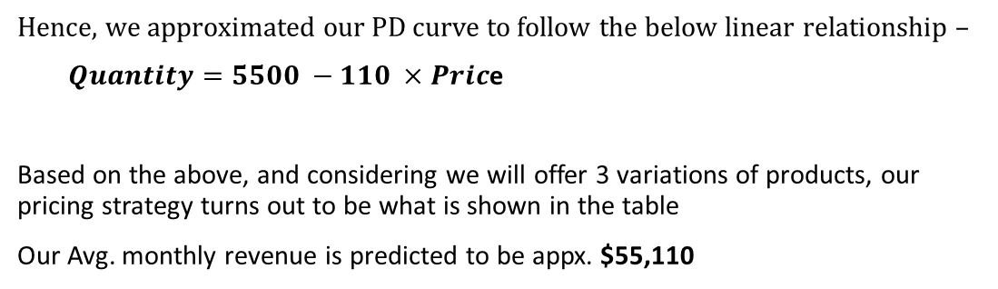
Hence, we approximated our PD curve to follow the below linear relationship –
$Quantity=5500 −110 ×Pric$e
Based on the above, and considering we will offer 3 variations of products, our pricing strategy turns out to be what is shown in the table
Our Avg. monthly revenue is predicted to be appx. $55,110
Version | Cost of Production | Sales Price | Optimal Quantity
Hermes | $2 | $10 | 990
Atlas | $6 | $19 | 550
Midas | $10 | $24 | 2860

Slide 13
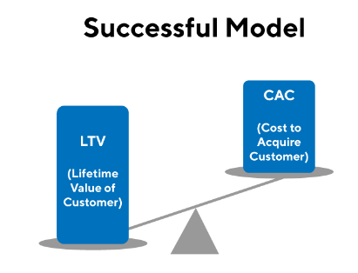
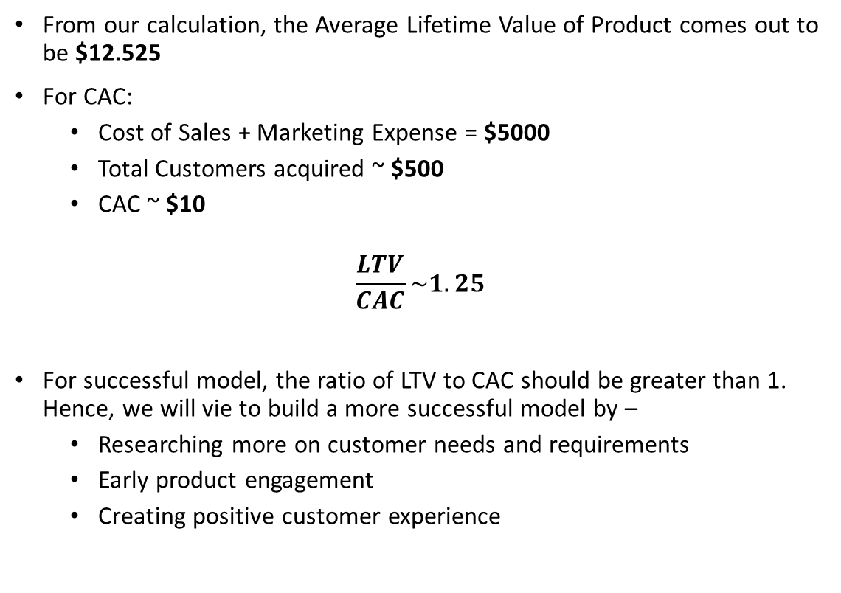
LTV and CAC
From our calculation, the Average Lifetime Value of Product comes out to be $12.525
For CAC:
Cost of Sales + Marketing Expense = $5000
Total Customers acquired ~ $500
CAC ~ $10
$$\frac{LTV}{CAC}\sim 1.25$$
For successful model, the ratio of LTV to CAC should be greater than 1. Hence, we will vie to build a more successful model by –
Researching more on customer needs and requirements
Early product engagement
Creating positive customer experience

Slide 14

Thank You

